Slide 1
Mushroom Database
Richard Schweiger
Adrien Desies
Maximilian Roederstein
Ayman Saleem

Slide 2
Organisation
Literature Research
Data Compression
Similarity Matrix Exploitation
Upcoming Tasks

Slide 3
Literature Research
TODO

Slide 4
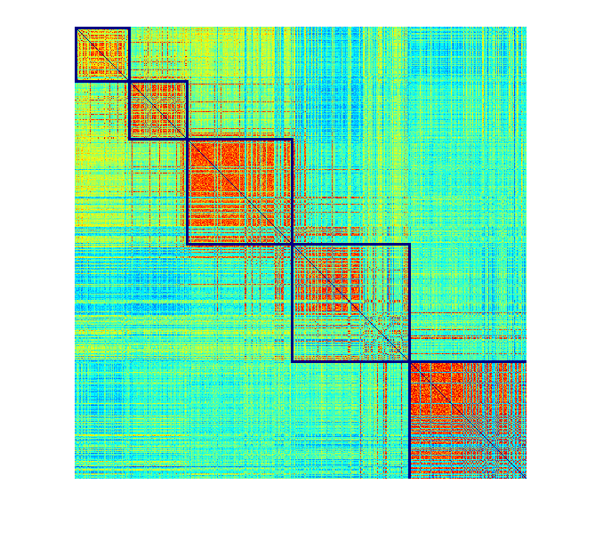
Similarity Matrix

Slide 5
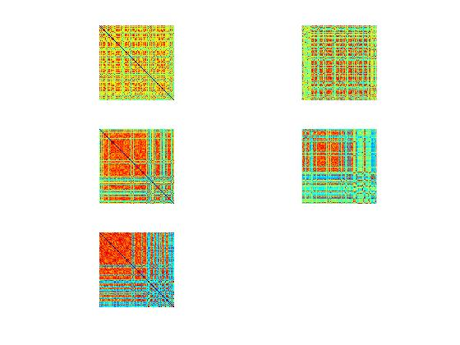
Similarity Matrix Initial Subgroups

Slide 6
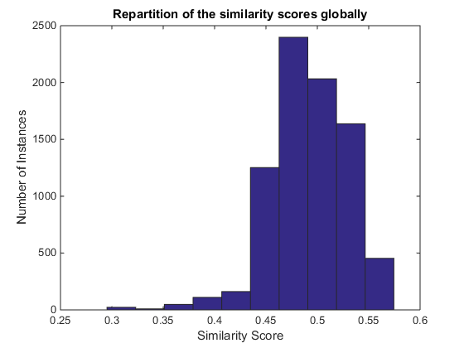
Average Similarity Distribution

Slide 7
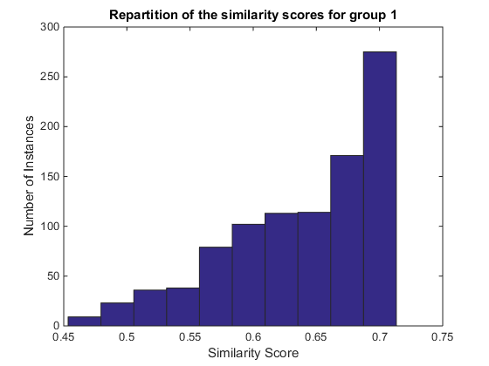
Average Similarity Distribution Group 1
Notes:
How many Samples are in group 1 / group 5?
Is there one feature where all are similar or is this randomly distributed between the features?

Slide 8
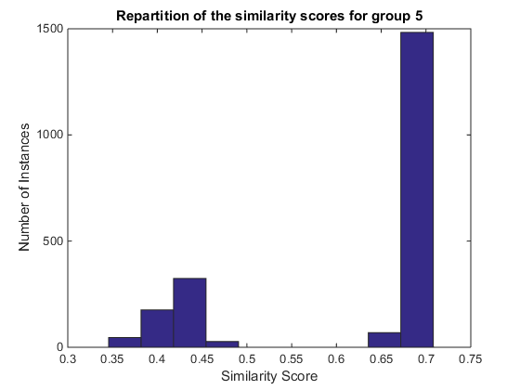
Average Similarity Distribution Group 5

Slide 9
Data Compression
Delete Redundant Features (threshold <95%)
Gill Attachment (97.42%)
Veil Type (100%)
Veil Color (97.54%)

Slide 10
Data Compression
Delete Redundant Characteristics (threshold > 95%)
Gill Spacing: characteristic 'distant'.
Stalk Root: characteristics 'cup' and 'rhizomorphs'.
Ring Type: characteristics 'cobwebby', 'sheathing' and 'zone'

Slide 11
Data Compression
Delete Redundant Characteristics (threshold = 0%)
Gill Spacing: characteristic 'distant'
Stalk Root: characteristics 'cup' and 'rhizomorphs'
Ring Type: characteristics 'cobwebby', 'sheathing' and 'zone'

Slide 12
Data Compression
Group Characteristics (threshold < 1%)
Cap Color: 'brown' + 'cinnamon' = 'brown'. 'green' + 'pink' = 'misc'
Ring Type: 'flaring' + 'none' = 'misc‘
Odor: 'musty' + 'foul' = 'foul'

Slide 13
Data Compression
Delete Strong Correlated Features (threshold > 95%)
Stalk Surface Above Ring + Stalk Surface Below Ring: 77.01%
Stalk Color Above Ring+ Stalk Color Below Ring:
62.38%

Slide 14
Upcoming Tasks
TODO:

